Slide 1
General Ledger and Reporting System
Learning Objectives
Describe the information processing operations required to update the general ledger and to produce reports for internal and external users.
Identify the major threats in general ledger and reporting activities and evaluate the adequacy of various control procedures for dealing with them.
Understand the implications of new IT developments, such as XBRL, and changes in external reporting requirements, such as IFRS, for the design and operation of the general ledger and reporting system.
Discuss how tools such as responsibility accounting, balanced scorecards, and graphs can be used to provide information managers need to effectively monitor performance.

Slide 2
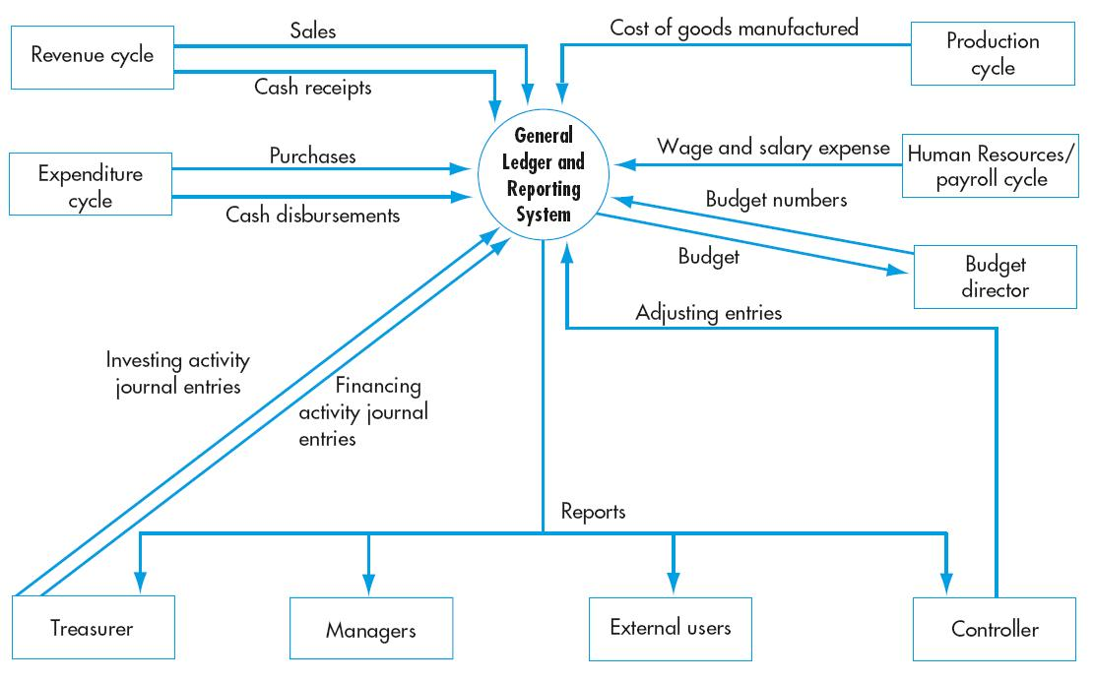
General Ledger and Reporting

Slide 3
General Ledger and Reporting
Primary function is to collect and organize
The accounting cycle activities
Financing activities
Investing activities
Budget activities
Adjustments

Slide 4
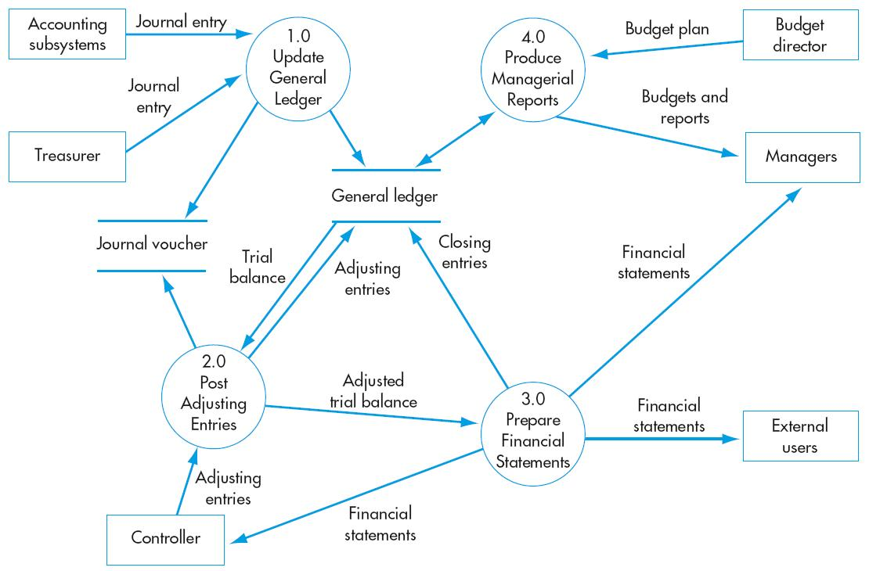
General Ledger and Reporting Activities
Update general ledger
Post adjusting entries
Prepare financial statements
Produce management reports

Slide 5
General Ledger and Reporting General Threats and Controls
Threats
Inaccurate or invalid general ledger data
Unauthorized disclosure of financial statement
Loss or destruction of data
Controls
Data processing integrity controls
Restriction of access to general ledger
Review of all changes to general ledger data
Access controls
Encryption
Backup and disaster recovery procedures

Slide 6
Update General Ledger Threats and Controls
Threats
Inaccurate updating of general ledger
Unauthorized journal entries
Controls
Data entry processing integrity controls
Reconciliations and control reports
Audit trail creation and review
Access controls
Reconciliations and control reports
Audit trail creation and review

Slide 7
Post Adjusting Entries Threats and Controls
Threats
Inaccurate adjusting entries
Unauthorized adjusting entries
Controls
Data entry processing integrity controls
Spreadsheet error protection controls
Standard adjusting entries
Reconciliations and control reports
Audit trail creation and review
Access controls
Reconciliations and control reports
Audit trail creation and review

Slide 8
Prepare Financial Statement Threats and Controls
Threats
Inaccurate financial statements
Fraudulent financial reporting
Controls
Processing integrity controls
Use of packaged software
Training and experience in applying IFRS
Audits

Slide 9
Produce Management Reports Threats and Controls
Threats
Poorly designed reports and graphs
Controls
Responsibility accounting
Balanced scorecard
Training on proper graph design

Slide 10
Balanced Scorecard
A report that provides a multidimensional perspective of organizational performance
Reflecting four perspectives of the organization
Financial
Customer
Internal operations
Innovation and learning
Showing goals and measures
Targets
Actual

